Slide 1
Module:2 Introduction To Software Project Management

Slide 2
SOFTWARE PROJECT MANAGEMENT
In the past, many projects failed not because there weren't skilled technical professionals or enough resources, but because of poor project management practices. Therefore, it is important to carefully learn the latest software project management techniques.
Objective: The main goal of software project management is to enable a group of developers to work effectively towards the successful completion of a project.

Slide 3
Management activities
Proposal writing
Project planning and scheduling
Project cost
Project monitoring and reviews
Personnel selection and evaluation
Report writing and presentations

Slide 4
Role of a project manager
A project manager is usually an experienced member of the team who essentially works as the administrative leader of the team.
For small software development projects, a single member of the team assumes the responsibilities for both project management and technical management.
For large projects, a different member of the team (other than the project manager) assumes the responsibility of technical leadership
The responsibilities of the technical leader includes addressing issues such as which tools and techniques to use, specific algorithms to use

Slide 5
SOFTWARE PROJECT MANAGEMENT COMPLEXITIES
Invisibility: Software remains invisible, until its development is complete and it is operational. Anything that is invisible, is difficult to manage and control.
The best that he can do perhaps is to monitor the milestones that have been completed by the development team and the documents that have been produced—which are rough indicators of the progress achieved.
Changeability: Because the software part of any system is easier to change as compared to the hardware part, the software part is the one that gets most frequently changed
Complexity: Even a moderate sized software has millions of parts (functions) that interact with each other in many ways—data coupling, serial and concurrent runs, state transitions, control dependency, file sharing, etc. Due to the inherent complexity of the functioning of a software product in terms of the basic parts making up the software, many types of risks are associated with its development. This makes managing these projects much more difficult as compared to many other kinds of projects.
Uniqueness: Every software project is usually associated with many unique features or situations. This makes every project much different from the others. Due to the uniqueness of the software projects, a project manager in the course of a project faces many issues that are quite unlike the others he had encountered in the past.
Exactness of the solution: Mechanical components such as nuts and bolts typically work satisfactorily as long as they are within a tolerance of 1 per cent or so of their specified sizes.
Team-oriented and intellect-intensive work:

Slide 6
Project planning
Project planning involves breaking down the work into parts and assign these to project team members, anticipate problems that might arise and prepare tentative solutions to those problems.
The project plan, which is created at the start of a project, is used to communicate how the work will be done to the project team and customers, and to help assess progress on the project.

Slide 7
Planning stages
At the proposal stage, when you are bidding for a contract to develop or provide a software system.
During the project startup phase, when you have to plan who will work on the project, how the project will be broken down into increments, how resources will be allocated across your company, etc.
Periodically throughout the project, when you modify your plan in the light of experience gained and information from monitoring the progress of the work.

Slide 8
Stage 1: Proposal planning
Planning may be necessary with only outline software requirements.
The aim of planning at this stage is to provide information that will be used in setting a price for the system to customers.
Project pricing involves estimating how much the software will cost to develop, taking factors such as staff costs, hardware costs, software costs, etc. into account

Slide 9
Stage 2: Project startup planning
At this stage, you know more about the system requirements but do not have design or implementation information
Create a plan with enough detail to make decisions about the project budget and staffing.
This plan is the basis for project resource allocation
The startup plan should also define project monitoring mechanisms
A startup plan is still needed for agile development to allow resources to be allocated to the project

Slide 10
Stage 3: Development planning
The project plan should be regularly amended as the project progresses and you know more about the software and its development
The project schedule, cost-estimate and risks have to be regularly revised

Slide 11
Plan-driven development
Plan-driven or plan-based development is an approach to software engineering where the development process is planned in detail.
Plan-driven development is based on engineering project management techniques and is the ‘traditional’ way of managing large software development projects.
A project plan is created that records the work to be done, who will do it, the development schedule and the work products.
Managers use the plan to support project decision making and as a way of measuring progress.

Slide 12
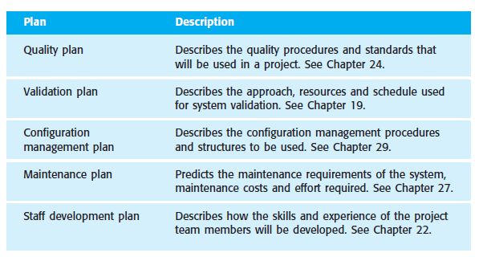
Project plan
The project plan sets out the resources available to the project, the work breakdown and a schedule for carrying out the work. In some organisations, the project plan is a single document that includes the different types of plan. In other cases, the project plan is solely concerned with the development process
Image: Ian Sommervile, pg no. 96

Slide 13
Most plans should include the following sections:
Introduction This briefly describes the objectives of the project and sets out the constraints (e.g., budget, time, etc.) that affect the project management.
Project organisation This describes the way in which the development team is organised, the people involved and their roles in the team.
Risk analysis This describes possible project risks, the likelihood of these risks arising and the risk reduction strategies that are proposed. I explain the principles of risk management in Section 5.4.
Hardware and software resource requirements This specifies the hardware and the support software required to carry out the development. If hardware has to be bought, estimates of the prices and the delivery schedule may be included.
Work breakdown This sets out the breakdown of the project into activities and identifies the milestones and deliverables associated with each activity. Milestones and deliverables are discussed in Section 5.2.2.
Project schedule This shows the dependencies between activities, the estimated time required to reach each milestone and the allocation of people to activities.
Monitoring and reporting mechanisms This defines the management reports that should be produced, when these should be produced and the project monitoring mechanisms used.

Slide 14
Milestones and Deliverables
Milestone reports need not be large documents. They may simply be a short report of what has been completed (significant events). Milestones should represent the end of a distinct, logical stage in the project. Indefinite milestones such as ‘Coding 80% complete’ that can’t be checked are useless for project management. You can’t check whether this state has been achieved because the amount of code that still has to be developed is uncertain.
A deliverable is a project result that is delivered to the customer. It is usually delivered at the end of some major project phase such as specification or design. Deliverables are usually milestones, but milestones need not be deliverables.

Slide 15
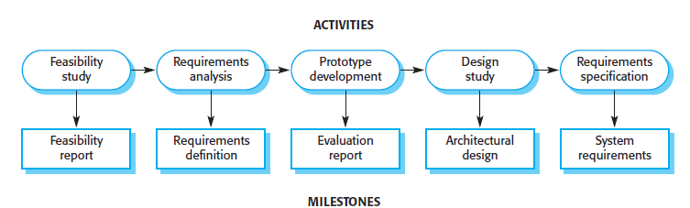
To establish milestones, the software process must be broken down into basic activities with associated outputs. For example, Figure shows possible activities involved in requirements specification when prototyping is used to help validate requirements. The milestones in this case are the completion of the outputs for each activity. The project deliverables, which are delivered to the customer, are the requirements definition and the requirements specification.

Slide 16
Work Breakdown Structure (WBS)
Hierarchical decomposition of the project to manageable components.
The decomposition is deliverable oriented
Displayed graphically.

Slide 17
SCHEDULING
Scheduling the project tasks is an important project planning activity.

Slide 18
Work Breakdown Structure (WBS)
Design: The WBS provides a graphical representation or textual outline of the project scope.
Some of the main roles the WBS plays in supporting clarity for project definition are that it:
Decomposes: the overall project scope into clearly defined deliverables.
Defines: the scope of the project in terms that the stakeholders can understand.
Provides: a structure for organizing information regarding the project’s progress, status, and performance.
Supports: tracking of risks to assist the project manager in identifying and implementing necessary responses

Slide 19
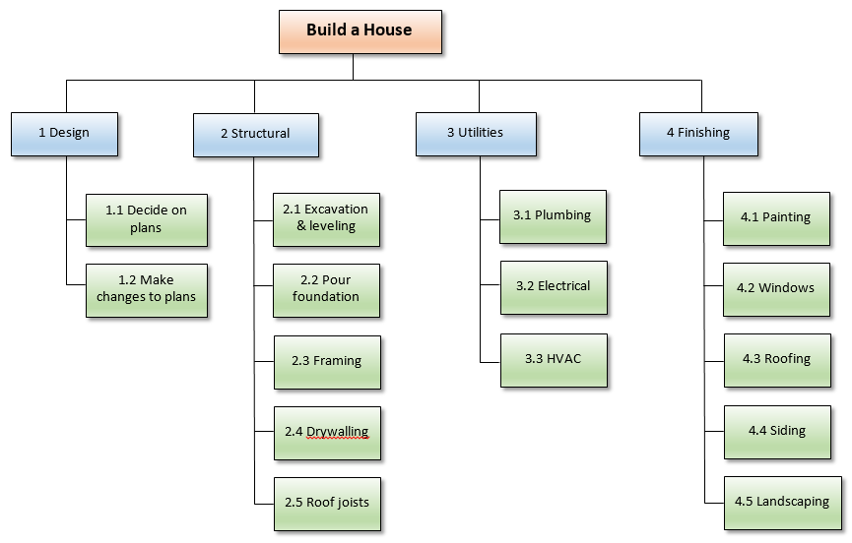
Example of WBS
Image courtesy: Internet

Slide 20
Benefits of WBS
Assists with accurate project organization
Helps with assigning responsibilities
Shows the control points and project milestones
Allows for more accurate estimation of cost, risk and time
Helps explain the project scope to stakeholders

Slide 21
Steps of WBS Step 1
Define the project’s end product. This is usually no more than a title: for example “construction of a buliding”. It forms the root of thr Work Breakdown Structure document.
Construction of a house

Slide 22
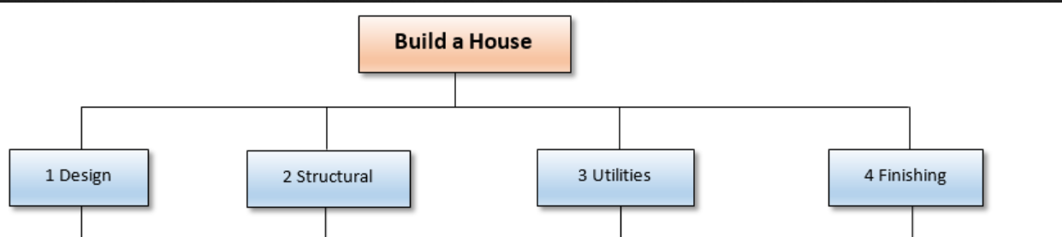
Step 2
Define the main deliverables

Slide 23
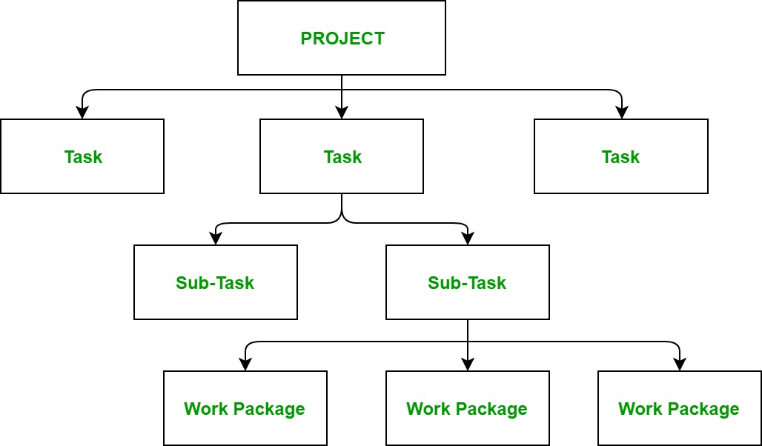
Step 3
Break down the main deliverables into their sub components using as many sub-branches as needed until you have manageable ‘units of work’ which need to be subdivided further.
These units of work should be of a size that the project manager can easily handle. For example, something that a worker or a team of workers can accomplish in a week might ne represented as a unit of work
Too much subdivision is counter productive as the product manger will then have to get too involved in the project details.

Slide 24
How long to decompose?
The decomposition of the activities is carried out until any of the following is satisfied:
A leaf-level sub-activity (a task) requires approximately two weeks to develop.
Hidden complexities are exposed, so that the job to be done is understood and can be assigned as a unit of work to one of the developers.
Opportunities for reuse of existing software components is identified

Slide 25
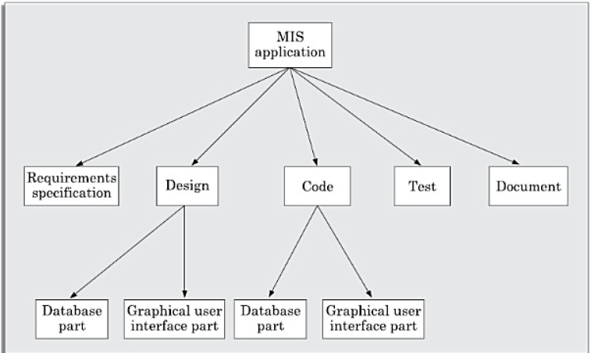
Example 2: management information system

Slide 26
GANTT CHART
Project management tool
Invented around 1915 by Henry Gantt
Similar to bar chart that depicts the project schedule
It is used for finding dependence between activities.
The different types of resources that need to be allocated to activities include staff, hardware, and software

Slide 27
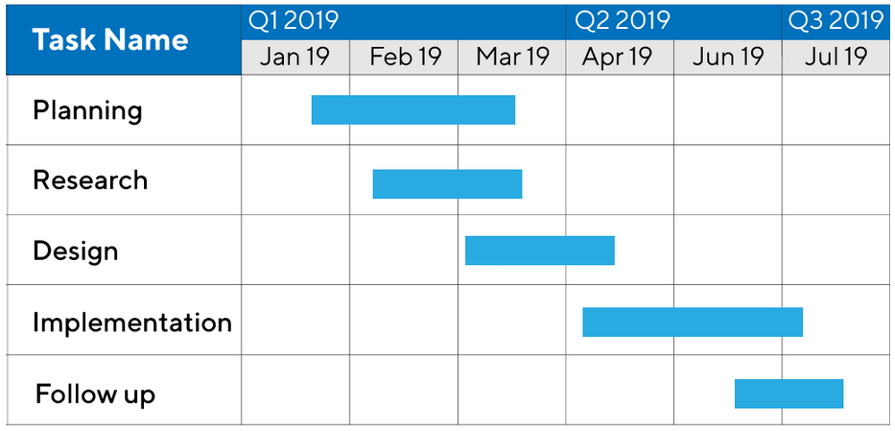
Example 1
Dependency
Parallelism
Duration
Subtask
deadlines
DURATION

Slide 28
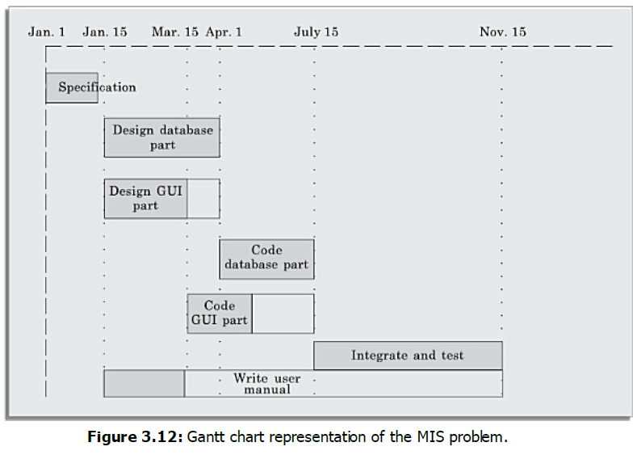
Example
Image courtesy: Rajib Mall

Slide 29
How to make GANTT Chart
Tasks are shown in the Y axis
Timeline in the X axis
Width of the bar is the duration of the task

